Slide 1



Mean Shift Image Segmentation
A Non-parametric Clustering Technique for Image Analysis
by
Navarasan N S M
2023510017

Slide 2
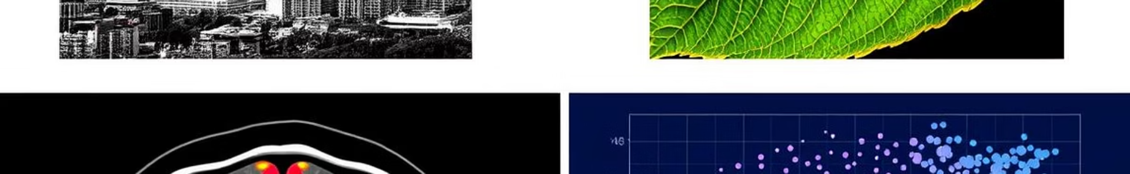
Introduction to Image Segmentation
What is Image Segmentation?
Importance
Dividing an image into meaningful regions for analysis.
Critical for object recognition, medical imaging, and scene understanding.
Common Techniques
Mean Shift
Thresholding
Mean Shift is a non-parametric clustering technique used to locate dense regions in data.
Edge-based
Region-based
Clustering-based

Slide 3
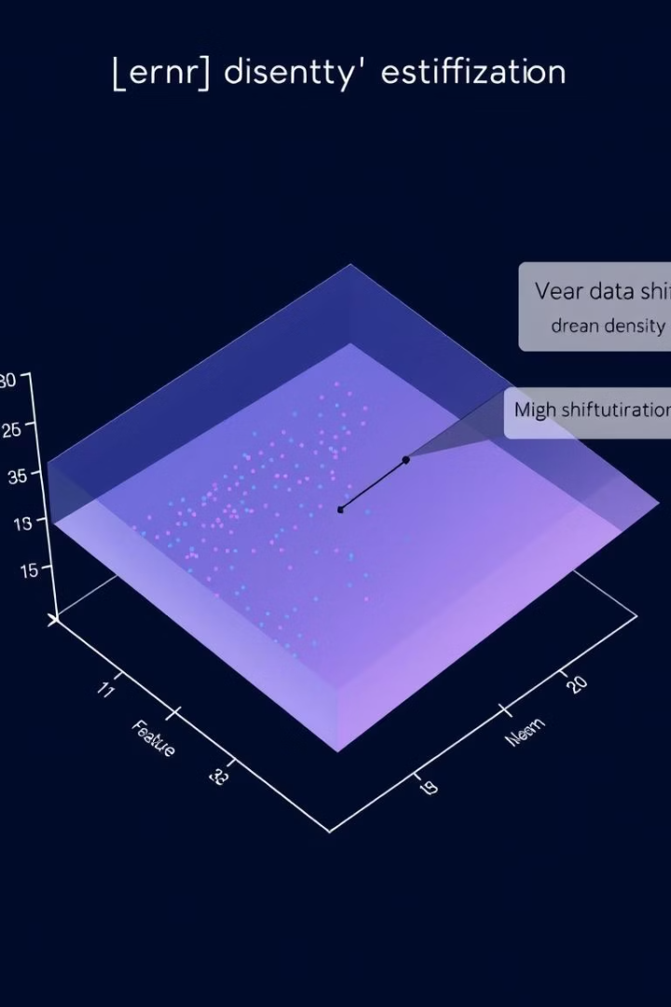
Understanding Mean Shift
Non-parametric Method
Iterative Process
Shifts points toward local maxima of data density (modes).
Does not assume a fixed distribution; uses kernel density estimation.
Data-Driven
Automatically finds cluster centers without pre-specifying their number.

Slide 4
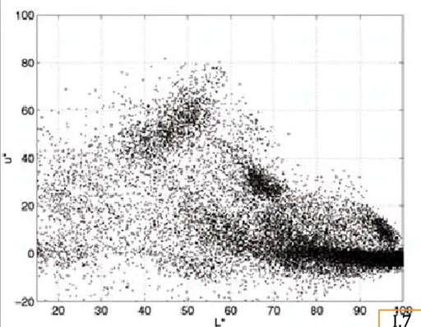
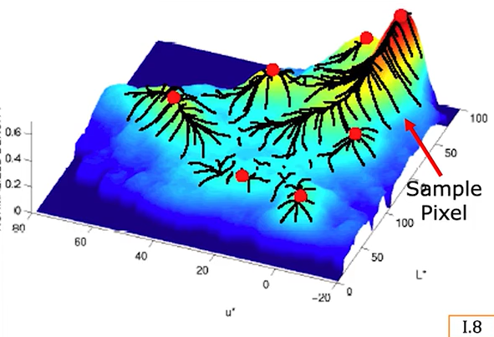
Pixel Feature Distribution
Normal Distribution
Each hill represents a cluster.
Peak (mode) of hill represents “center” of cluster.
Each pixel climbs the steepest hill within its neighborhood.
Pixel assigned to the hill (cluster) it climbs.

Slide 5
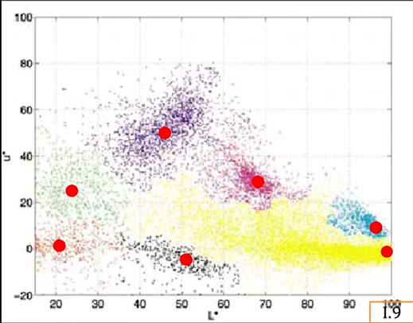
Pixel Feature Distribution
Colored Pixel Feature Distribution
Each hill represents a cluster.
Peak (mode) of hill represents “center” of cluster.
Each pixel climbs the steepest hill within its neighborhood.
Pixel assigned to the hill (cluster) it climbs.

Slide 6
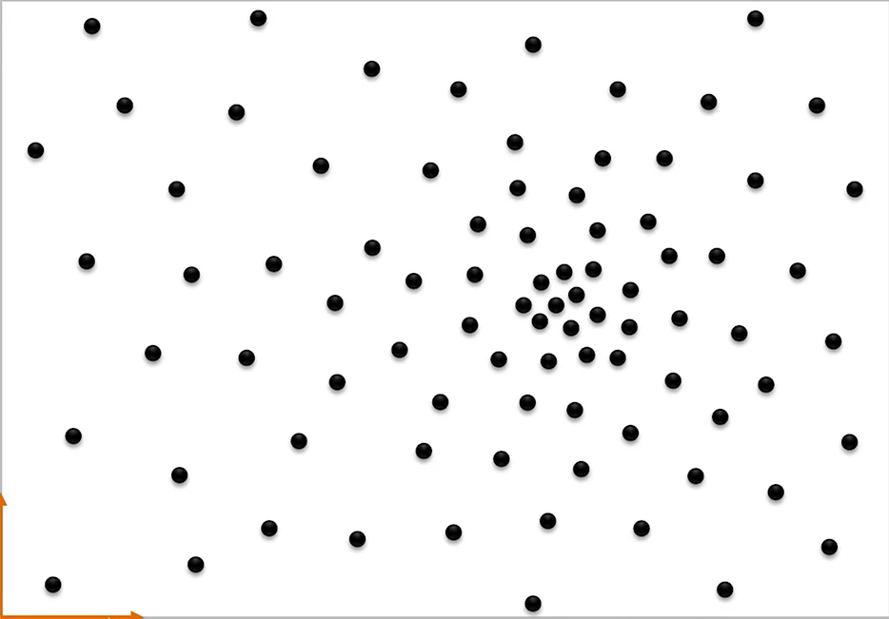
Hill-Climb using Mean-shift

Slide 7
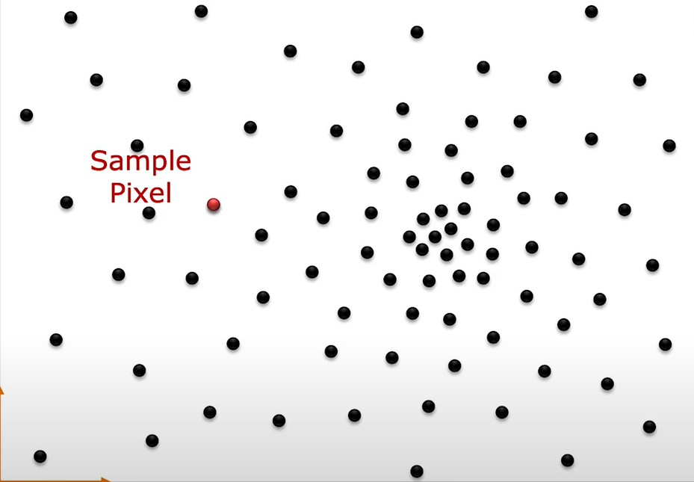
Hill-Climb using Mean-shift
Select a random pixel to initiate

Slide 8
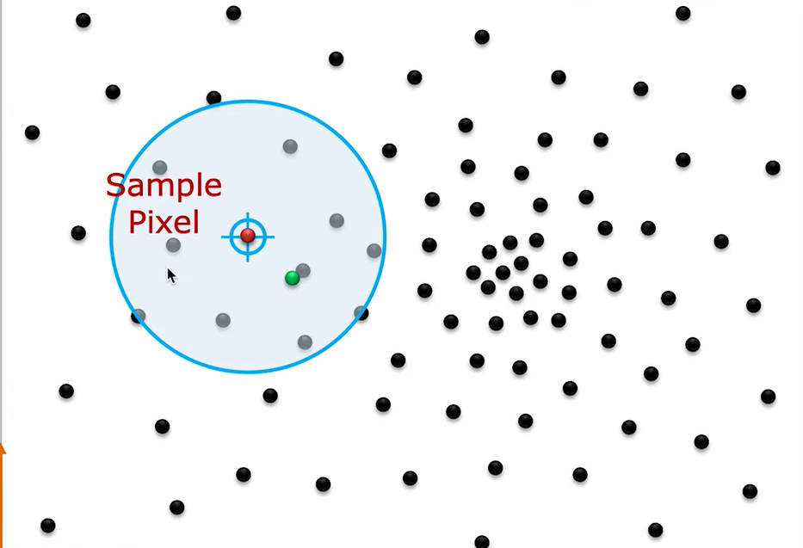
Hill-Climb using Mean-shift
Compute a ( . ) centroid within the window W

Slide 9
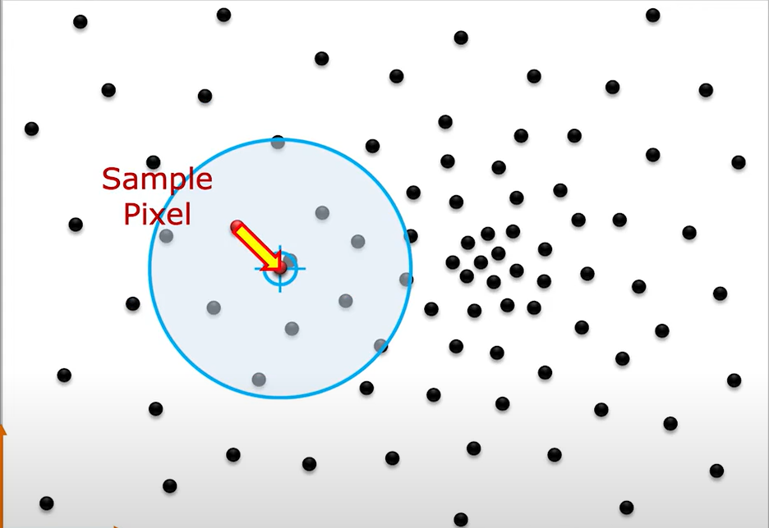
Hill-Climb using Mean-shift
Shift the mean to the centroid

Slide 10
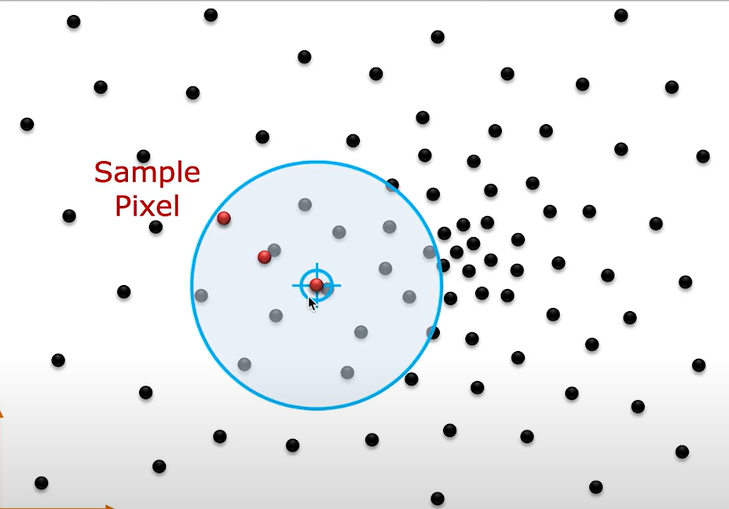
Hill-Climb using Mean-shift
Repeat untill it converge

Slide 11
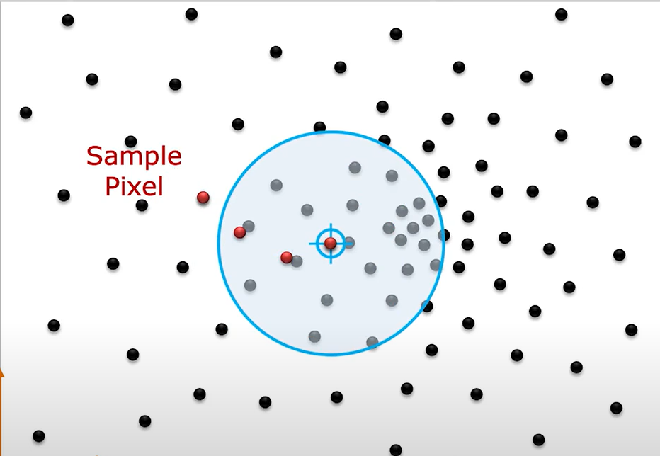
Hill-Climb using Mean-shift
Repeat untill it converge

Slide 12
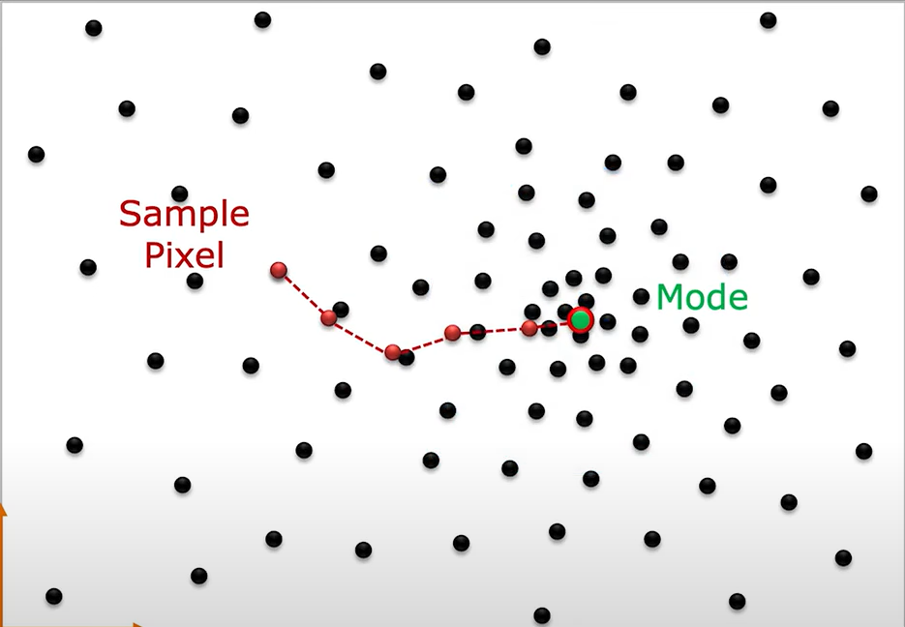
Hill-Climb using Mean-shift
Declare mode and assign it as cluster label

Slide 13
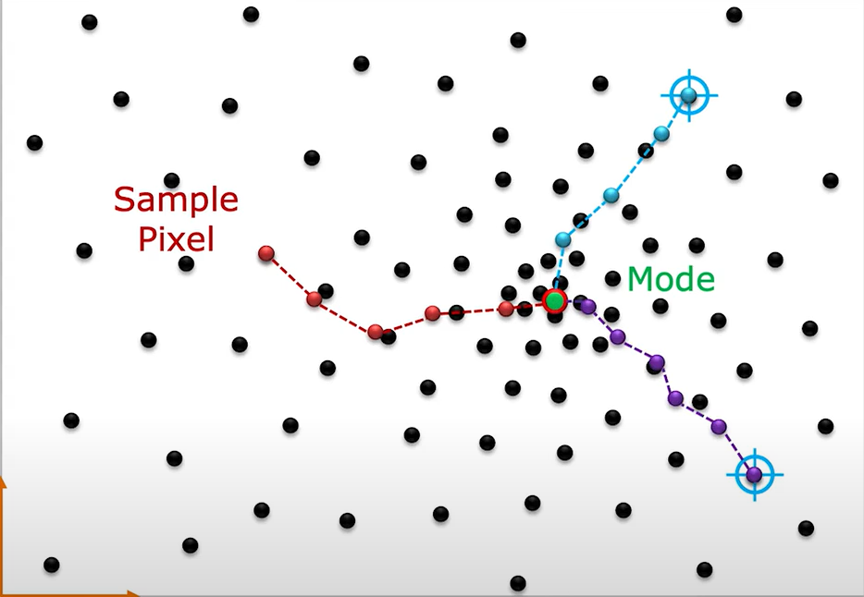
Hill-Climb using Mean-shift
Repeat for all pixels

Slide 14
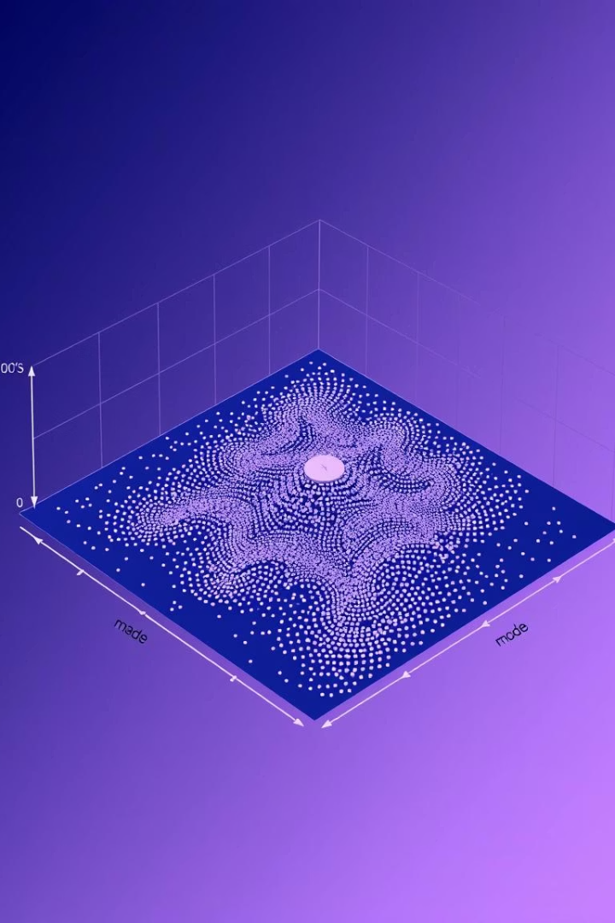
Mean-shift Algorithm
Given: Distribution of N pixels in feature space.
Task: Find modes (clusters) of the distribution.
Clustering Steps:
Set mᵢ = fᵢ as the initial mean for each pixel i.
Repeat the following for each mean mᵢ:
a. Place a window of size W around mᵢ.
b. Compute the centroid m within the window. Set mᵢ = m.
c. Stop if the shift in mean mᵢ is less than a threshold ε.
3. Then mᵢ is the mode.
4. Label all pixels that have the same mode as belonging to the same cluster.

Slide 15




Visual Comparison of Segmentation Methods
Original Image
Raw input with complex structures and colors.
Original Image
Mean-shift
Mean Shift Output
Smoothly segmented with clear boundaries and fewer artifacts.
Other Methods
K-means and graph cut show varying boundary sharpness and cluster shapes.
K-means
Graph cut

Slide 16


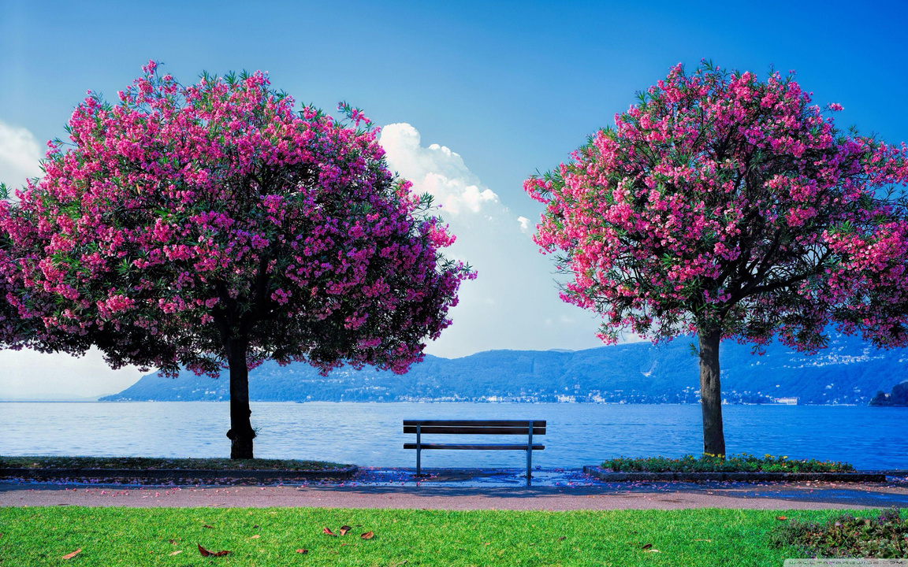
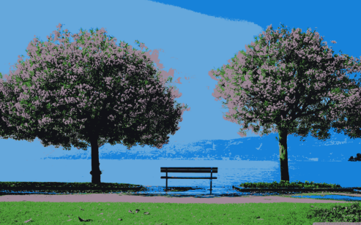
Mean-shift Outputs

Slide 17

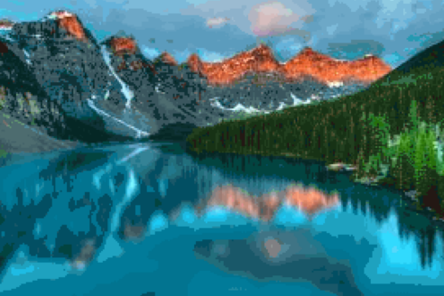


Mean-shift Outputs

Slide 18





Advantages of Mean Shift Segmentation
No Predefined Clusters
Arbitrary Shape
Smooth Boundaries
Clusters of any shape can be detected accurately.
Dynamic detection of cluster count from data.
Produces visually coherent segment borders.
Noise Robust
Less sensitive to noise compared to other clustering methods.

Slide 19

Limitations and Challenges
Computational Cost
Bandwidth Selection
Iterative shifting is computationally intensive on large images.
Bandwidth parameter heavily influences segmentation quality.
Scalability
Scaling to high-dimensional features or large datasets is challenging.

Slide 20
Applications of Mean Shift
Object Tracking
Image Segmentation
Tracks object contours by following modes in feature space.
Separates objects/regions for recognition and analysis.
Mode Detection
Scene Understanding
Detects dense regions for data analysis in many contexts.
Aids in comprehending complex environments and structures visually.

Slide 21
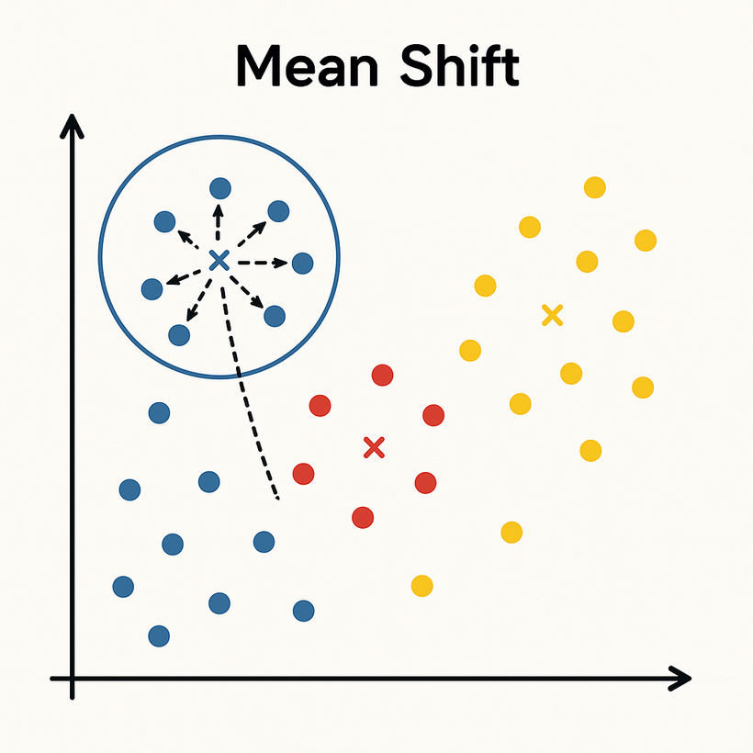




Mean Shift comments
Simple but computationally expensive
Finds arbitrary number of clusters
No initialization required
Robust to outliers

Slide 22


